Slide 1
GRAPH PLOTTER & CALCULATOR
TEAM ID : 403

Slide 2
TEAM MEMBERS
VINEET MANGAL 140040028
SUBHRANGSU SAHA 140040088
GAURAV AGRAWAL 140040018
KRISHNA PAL 140040048

Slide 3
GOAL OF PROJECT
GOAL OF THIS PROJECT IS TO MAKE A USER FRIENDLY PROGRAM TO MAKE GRAPHS OF VARIOUS FUNCTIONS.

Slide 4
DIVISION OF THE PROJECT WORK
OUR TWO TEAM MEMBERS, VINEET AND SUBHRANGSU WORKED ON THE INTERFACE AND SOME OF THE FUNCTIONS TO REDUCE THE BURDEN OF OTHER TEAM MEMBERS.
AND REMAINING TWO, KRISHNA AND GAURAV WORKED ON THE MAKING OF REMAINING FUNCTIONS AND WRITES THE CODE FOR KOOLPLOT.
BASICALLY, WE DIVIDED OUR IN A FAIR ENOUGH WAY SO THAT NO TEAM MEMBER HAS TO DO EXTRA WORK.

Slide 5
IMPLEMENTATION
FRISTLY, WE ADDED KOOLPLOT LIBRARY WHICH MAKES IT EASIER TO DRAW GRAPHS OF FUNCTIONS.
THEN AFTER WE WORKED ON INTERFACE, MEANS TO ENTER THE FUNCTION INTO THE PROGRAM.

Slide 6
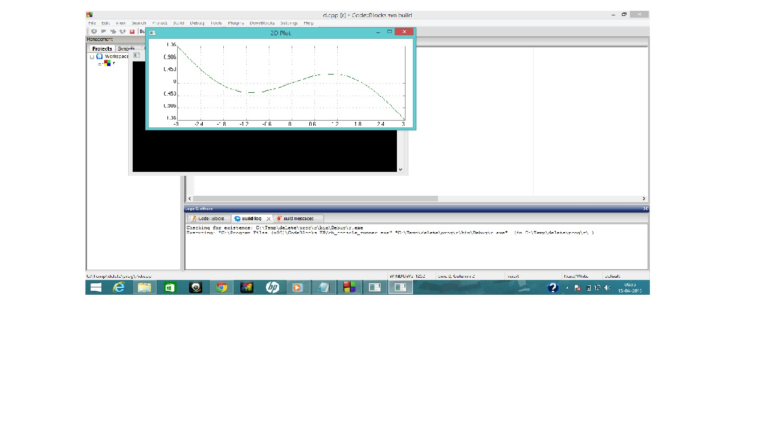
PROJECT SCREENSHOTS
GRAPH OF Y=sin(x)-0.5*x

Slide 7
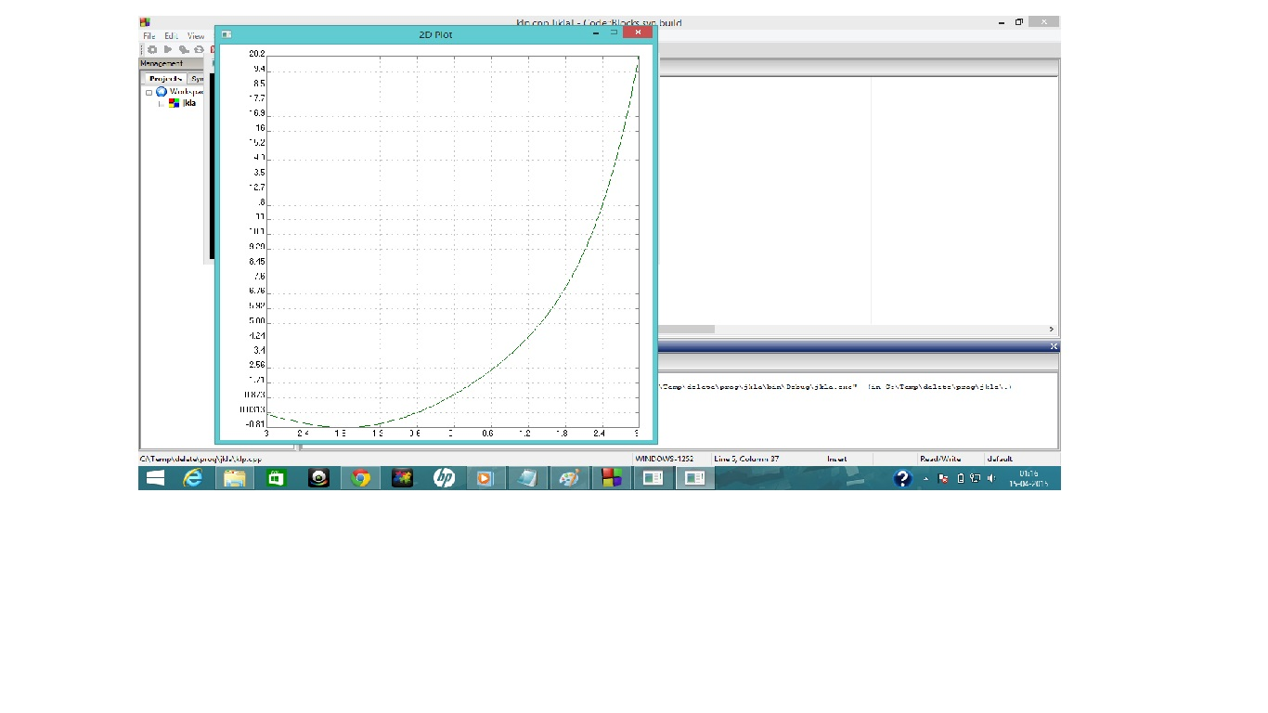
PROJECT SCREENSHOTS
GRAPH OF
Y=exp(x)+sin(x)

Slide 8
CHALLENGES
CREATING THE INTERFACE FOR GRAPH PLOTTER WAS A CHALLENGING TASK.
COMBINING THE CALCULATOR WITH PLOTTER WAS NOT ALSO EASY.
MAKING OF A INTERFACE FOR TAKING INPUT OF FUNCTION FROM A USER IS A DIFFICULT TASK BECAUSE IT NEEDS SOME EXTRA CONCEPTS IN CS.

Slide 9
INNOVATIONS
INTRODUCED THE CONCEPT OF MULTIPLE GRAPHS IN A SINGLE WINDOW IN DIFFERENT COLORS TO COMPARE B/W 2 OR MORE GRAPHS.
ADDITIONALLY, STANDARD CALCULATOR IS ALSO THERE ALONG WITH THIS GRAPH PLOTTER FOR CALCULATIONS.

Slide 10
INNOVATIONS
CO-ORDINATES OF ANY POINT CAN BE OBTAINED JUST BY CLICKING ON DESIRED POINT. USEFUL IN GETTING THE INTERSECTION OF TWO OR MORE THAN TWO CURVES.

Slide 11
FUTURE WORKS
THIS PROJECT CAN BE MEANINGFULLY EXTENDED TO 3D GRAPH PLOTTER.
CAN PLOT DIFFERENT TYPES OF FUCTION, SO CAN BE USED IN HIGHER STUDIES IN WHICH GRAPHS ARE USED FOR ANALYSIS.
THIS CALCULATOR CAN BE DEVELOPED TO A COMPLETE SCIENTIFIC CALCULATOR WHICH CAN BE USED COMMERCIALLY.

Slide 12
THANK YOU

